Slide 1

Advanced SQL
9 April 2026
Lynette Barnard

Slide 2
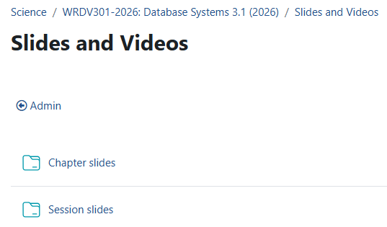
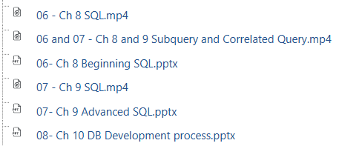
Resources reminder
Chapter 9 - Advanced SQL

Slide 3

Tips and Tricks: UNION, INTERSECT, MINUS
Only work on union-compatible tables
Union-compatible
Same number of attributes
Data types identical (or in some SQL dialects, compatible)
Identical is safest option
Chapter 9 - Advanced SQL

Slide 4
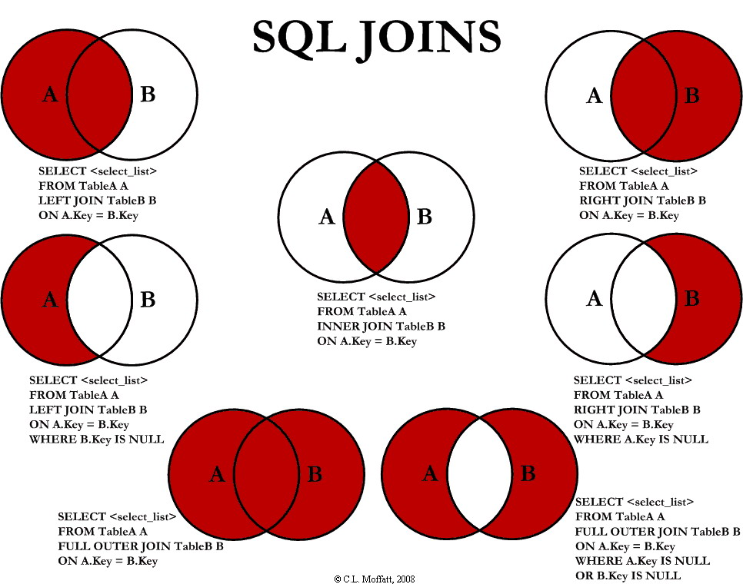
This Photo by Unknown author is licensed under CC BY-SA.

Slide 5
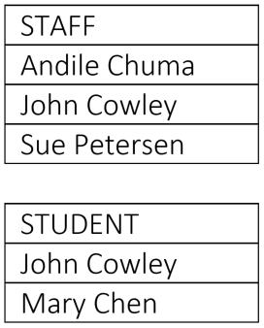
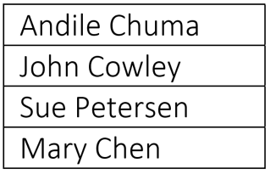
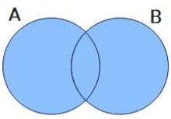
UNION
Staff & Students
Some staff may be students too
Give the resultant set for
staff UNION student
https://www.edrawmax.com/article/venn-diagram-symbols-and-set-notations.html
Chapter 9 - Advanced SQL

Slide 6
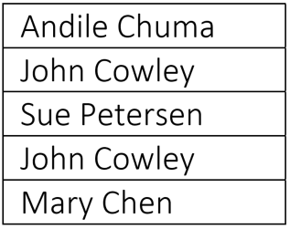
UNION ALL
Staff & Students
Some staff may be students too
Give the resultant set for
staff UNION ALL student
https://www.edrawmax.com/article/venn-diagram-symbols-and-set-notations.html
Chapter 9 - Advanced SQL

Slide 7

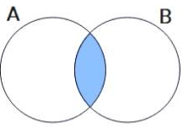
INTERSECT
Staff & Students
Some staff may be students too
Give the resultant set for
staff INTERSECT student
https://www.edrawmax.com/article/venn-diagram-symbols-and-set-notations.html
Chapter 9 - Advanced SQL

Slide 8
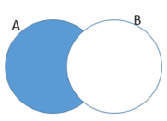
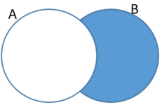
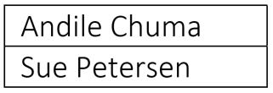

MINUS
A
Staff & Students
Some staff may be students too
Give the resultant set for
staff (A) MINUS student (B)
B
Give the resultant set for
student (B) MINUS staff (A)
Chapter 9 - Advanced SQL

Slide 9

Assignment Feedback
Take responsibility for your (in)action
Follow instructions…
Copy and paste the SQL (NOT screen snips)
Give resultant sets
Join conditions required when joining tables (# of tables - 1)
NO old style joins
Use ONLY required tables
Check which tables contain what you require
Difference between COUNT and SUM
Chapter 9 - Advanced SQL

Slide 10
Test feedback: Comments per Question
Q 1a: Relational schema and normal form (check “repeating groups”; see Figure 7.1, p 274)
Q 1b: Multi-valued attribute (an attribute with potential multiple values)
Q 1c: Two partial and one transitive dependency
Q 2a: Relationship degree (unary, binary, ternary); ternary does NOT contain multiple binaries
Q 2b: Strong / weak entity (motivate using both conditions for weak; mandatory FK; natural PK; existence dependent)
Q3 (Slides 9 – 13 of 5 Mar)
Q4: Inheritance implementation – see e.g. slide 11 of 19 Feb; slides 9 & 10 of 5 Mar
UML asked; specifically Visio’s UML Database Notation

Slide 11
Test feedback
Average 65% (30 distinctions)
Test moderated externally (question paper and selection of scripts)
Test queries until Friday, 17 April @ 11:00 (thereafter marks are final)

Slide 12

Class mystery
SQL skills
Problem solving skills
Fun
May work in teams of max 3 to solve the mystery
Image by freepik
Chapter 9 - Advanced SQL

Slide 13

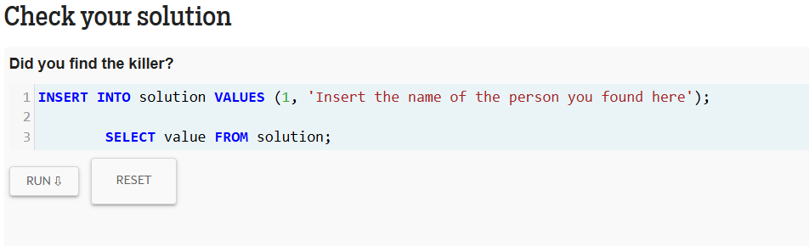
Process https://mystery.knightlab.com/
Use queries to find murderer and mastermind behind murder
Take screenshot of ONLY your results (nothing else!) once you’ve run this query (twice – once for murderer and once for mastermind):
Upload your results to FUNDA
Same submission process as assignments, e.g.
Team member names in header of document
Save result as pdf (use submitting member surname as filename)
Upload to 07 Murder Mystery by tomorrow morning @ 08:00
Image by freepik

